Slide 1
File Systems

Slide 2
Files and directories / 1
to implement a file system, a translation problem: how to go from file name and offset to a block number?
simple answer: file systems implement a dictionary that maps keys (file name and offset) to values (block number on a device).
Already have many data structures for dictionaries; can we just use one?
Not so simple.

Slide 3
Files and directories / 2
Four major challenges:
Performance
provide good performance while coping with underlying storage device limitations.
FS try to ensure good spatial locality, where blocks that are accessed together are stored near one another, ideally in sequential storage blocks.
Flexibility.
One major FS purpose: allowing applications to share data.
File systems “must” be jacks-of-all-trades.
“Less useful” if one file system for large sequentially-read files, another for small seldom-written files, another for large random-access files, another for short-lived files, and so on.
In practice, specialization also common (e.g., on palmetto)

Slide 4
Files and directories / 3
Persistence. File systems must maintain and update user data, and internal data structures so that everything survives operating system crashes and power failures.
Reliability. File systems must be able to store important data for long periods of time, even if machines crash during updates or some of the system’s storage hardware malfunctions. Ch14.

Slide 5
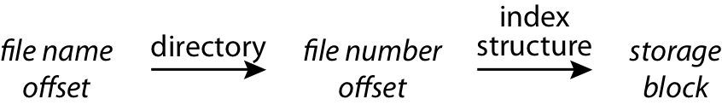
Named Data in a File System

Slide 6

Directories Are [generally] Files

Slide 7
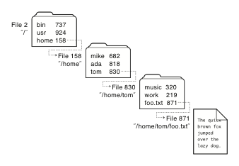
Recursive Filename Lookup

Slide 8
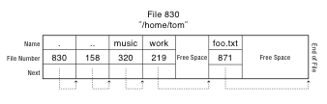
Directory Layout
Directory stored as a file
Linear search to find filename (small directories)
“Many early implementations simply stored linear lists of
file name, file number pairs in directory files.
…in original version of the Linux ext2 file system, each directory file stored a linked list of directory entries”

Slide 9
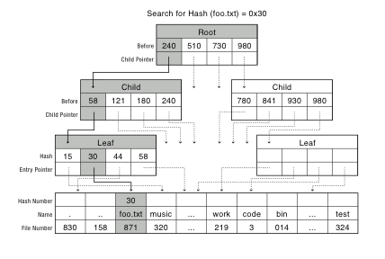
Large Directories: B Trees

Slide 10

Large Directories: Layout

Slide 11
File System Design Constraints
For small files:
Small blocks for storage efficiency
Files used together should be stored together
For large files:
Contiguous allocation for sequential access
Efficient lookup for random access
May not know at file creation
Whether file will become small or large

Slide 12
File System Design
Data structures
Directories: file name -> file metadata
Store directories as files
File metadata: how to find file data blocks
Free map: list of free disk blocks
How do we organize these data structures?
Device has non-uniform performance

Slide 13
Design Challenges
Index structure
How do we locate the blocks of a file?
Index granularity
What block size do we use?
Free space
How do we find unused blocks on disk?
Locality
How do we preserve spatial locality?
Reliability
What if machine crashes in middle of a file system op?

Slide 14
File System Design Options
 | FAT | FFS | NTFS
Index structure | Linked list | Tree (fixed, assym) | Tree (dynamic)
granularity | block | block | extent
free space allocation | FAT array | Bitmap (fixed location) | Bitmap (file)
Locality | defragmentation | Block groups + reserve space | Extents Best fit defrag

Slide 15
Named Data in a File System

Slide 16
Microsoft File Allocation Table (FAT)
Linked list index structure
Simple, easy to implement
Still widely used (e.g., thumb drives)
File table:
Linear map of all blocks on disk
Each file a linked list of blocks

Slide 17
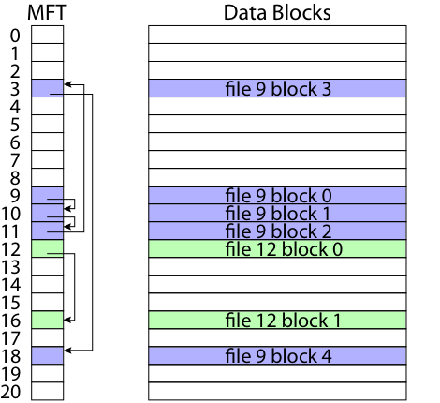
FAT

Slide 18
FAT
Pros:
Easy to find free block
Easy to append to a file
Easy to delete a file
Cons:
Small file access is slow
Random access is very slow
Fragmentation
File blocks for a given file may be scattered
Files in the same directory may be scattered
Problem becomes worse as disk fills

Slide 19
Berkeley UNIX FFS (Fast File System)
inode table
Analogous to FAT table
inode
Metadata
File owner, access permissions, access times, …
Set of 12 data pointers
With 4KB blocks => max size of 48KB files

Slide 20
FFS inode
Metadata
File owner, access permissions, access times, …
Set of 12 data pointers
With 4KB blocks => max size of 48KB files
Indirect block pointer
pointer to disk block of data pointers
Indirect block: 1K data blocks => 4MB (+48KB)

Slide 21
FFS inode
Metadata
File owner, access permissions, access times, …
Set of 12 data pointers
With 4KB blocks => max size of 48KB
Indirect block pointer
pointer to disk block of data pointers
4KB block size => 1K data blocks => 4MB
Doubly indirect block pointer
Doubly indirect block => 1K indirect blocks
4GB (+ 4MB + 48KB)

Slide 22
FFS inode
Metadata
File owner, access permissions, access times, …
Set of 12 data pointers
With 4KB blocks => max size of 48KB
Indirect block pointer
pointer to disk block of data pointers
4KB block size => 1K data blocks => 4MB
Doubly indirect block pointer
Doubly indirect block => 1K indirect blocks
4GB (+ 4MB + 48KB)
Triply indirect block pointer
Triply indirect block => 1K doubly indirect blocks
4TB (+ 4GB + 4MB + 48KB)

Slide 23
FFS
Pros
Efficient storage for both small and large files
Locality for both small and large files
Locality for metadata and data
Cons
Inefficient for tiny files (a 1 byte file requires both an inode and a data block)
Inefficient encoding when file is mostly contiguous on disk (no equivalent to superpages)
Need to reserve 10-20% of free space to prevent fragmentation

Slide 24
NTFS
Master File Table
Flexible 1KB storage for metadata and data
Extents
Block pointers cover runs of blocks
Similar approach in linux (ext4)
File create can provide hint as to size of file
Journalling for reliability
Next chapter

Slide 25
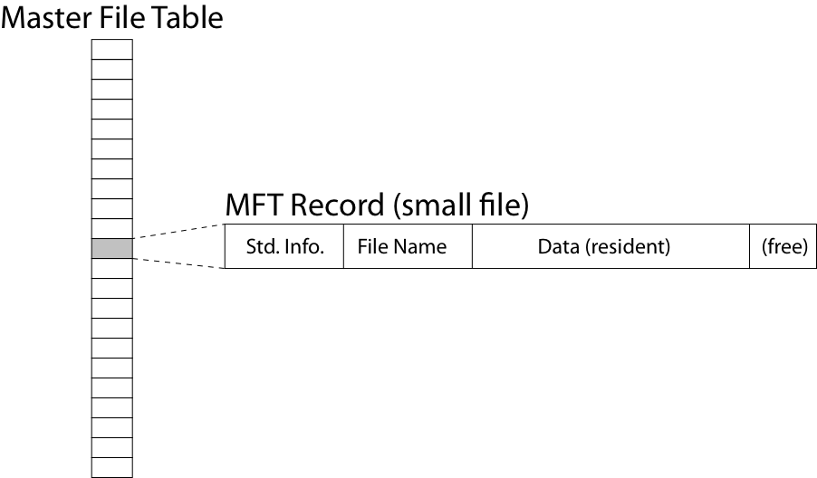
NTFS Small File

Slide 26
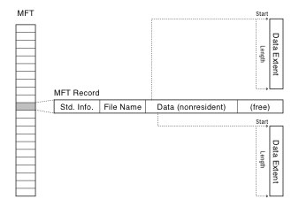
NTFS Medium-Sized File

Slide 27
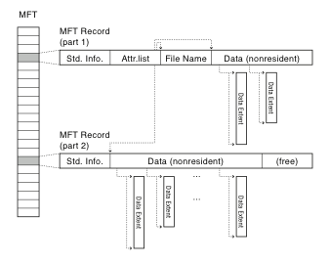
NTFS Indirect Block

Slide 28
